Slide 1
A Review of the Clinical Trials Evidence Base Demonstrating the Efficacy of Ivermectin in the Prophylaxis and Treatment of COVID-19
Pierre Kory, MD, MPA
President, Front Line Covid-19 Critical Care Alliance

Slide 2
Add more epidemiology
Add more NIH recommendation stuff – give it a “break down”
Talk about how “proper trials etc
Put in some FAQ’s – answer the NIH’s critique/recommendation

Slide 3
AGENDA
Conduct a Review of:
The emerging clinical evidence for ivermectin as an effective therapy in prophylaxis, early, and late hospital disease phases

Slide 4
Disclosures
NONE
Note: All statements and information in this lecture are referenced in our review manuscript posted on the pre-print server OSF 10.31219/osf.io/wx3zn
*Our manuscript just passed three rounds of peer review and has been accepted for publication in Frontiers in Pharmacology as of 1/3/21

Slide 5
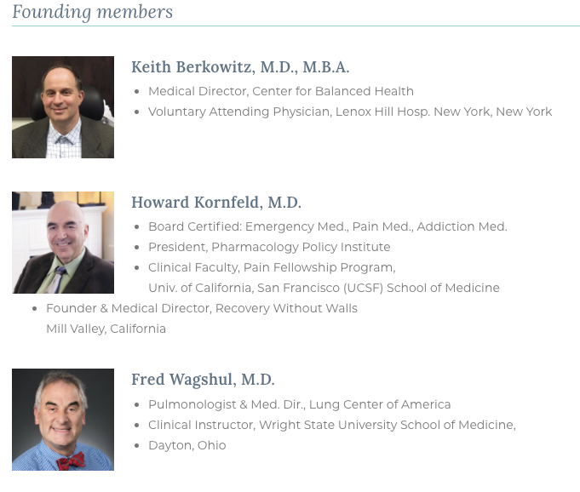
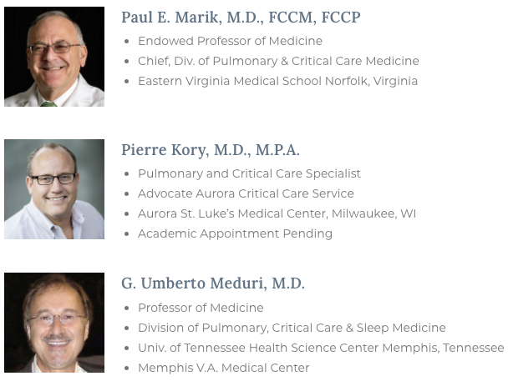
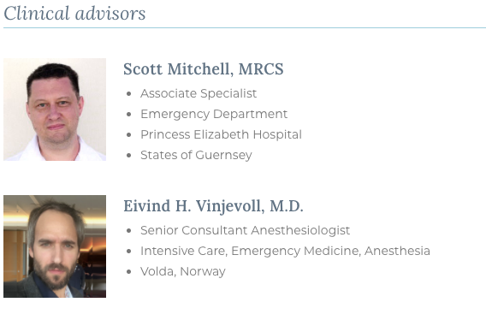
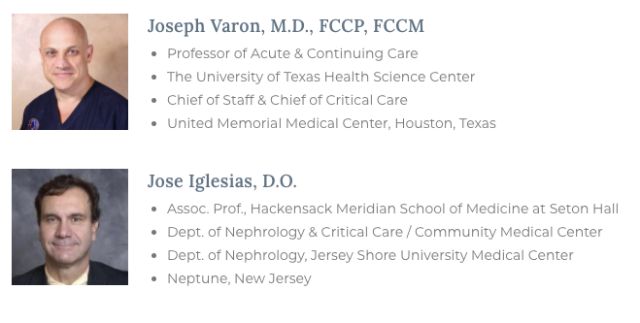
THE FLCCC ALLIANCE

Slide 6
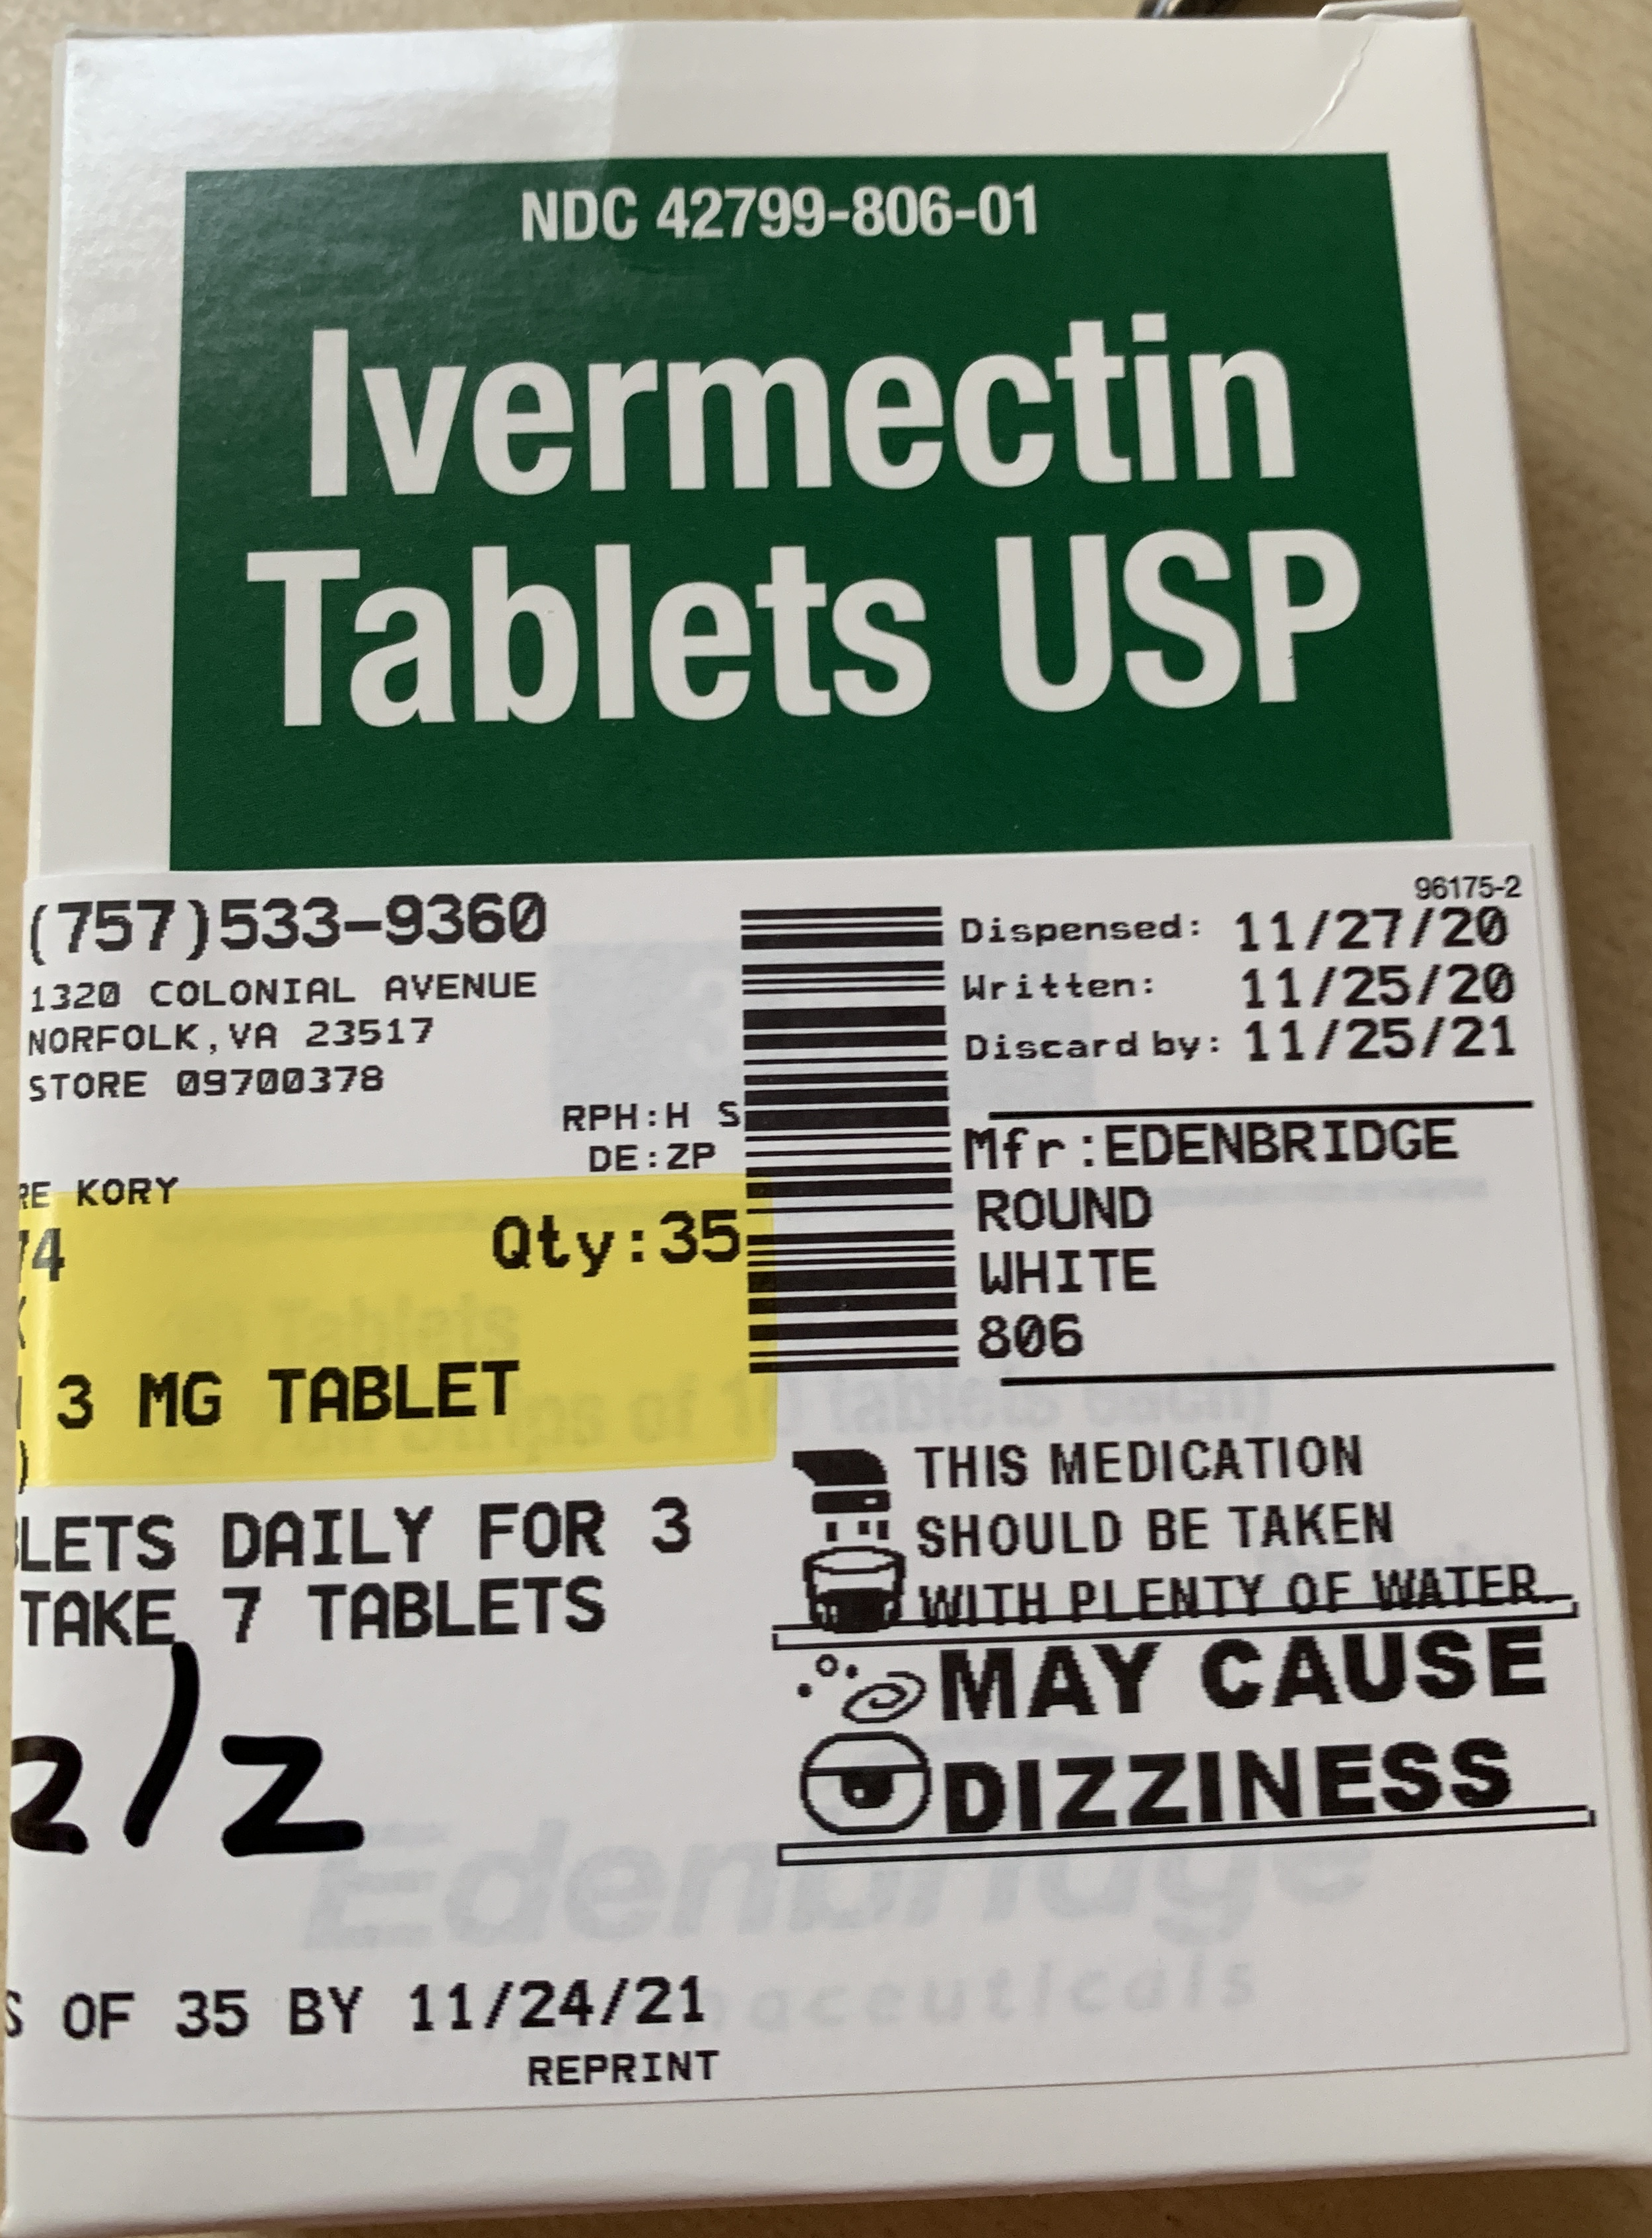
IVERMECTIN
• 40-year-old anti-parasitic drug
Used safely by 3.7 billion people worldwide.
• Discovery awarded Nobel Prize in 2015
On the W.H.O.’s list of “essential medicines.”

Slide 7
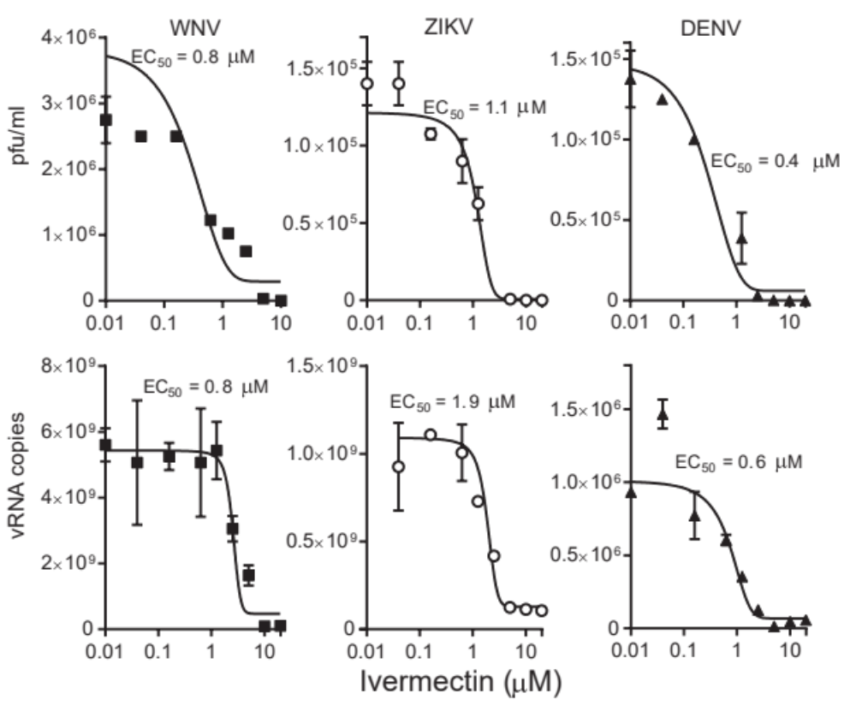
Ivermectin has anti-viral activity in vitro against a range of viruses

Slide 8
Proposed Anti-Viral Mechanisms/SARS-CoV-2
Binds to spike protein, disrupting binding with ACE-2 receptor – preventing entry
Binds to multiple essential structural and non-structural proteins required for replication
Binds to SARS-CoV-2 RNA dependent RNA polymerase, inhibiting viral replication
Prevents importin mediated entry into cell nucleus?

Slide 9
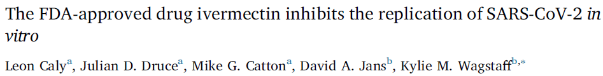
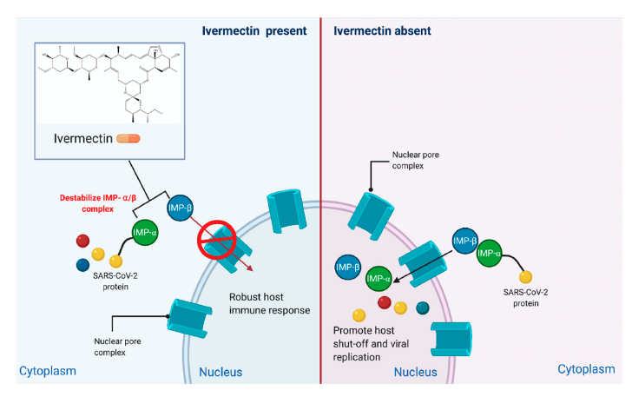
With a single addition of IVERMECTIN to Vero-hSLAM cells 2 h post infection with SARS-CoV-2 able to effect ~5000-fold reduction in viral RNA at 48 h.
Orf6
Nucleocapsid
NFκB
Antiviral Research 2020;178:104787

Slide 10
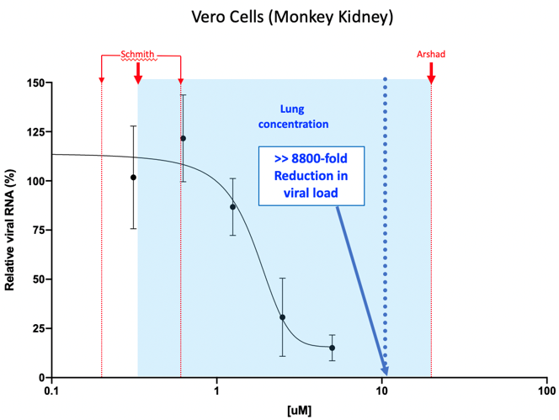
Ivermectin inhibits SARS-CoV-2 in vitro
Relevance of IC₅₀ determined in vitro to clinical use?
In vitro assay very different from clinical situation
  Vero/hSLAM cells- monkey kidney- do not produce IFN
  Lack immune responses
Ivermectin accumulates in lungs and other tissues (3x-10x serum levels)
Human lung cells- better IC₅₀
Short exposure vs extended exposure
Single dose vs repeat dosing
Taken with food (3x level)
Red- peer-reviewed, published modelling of IVM lung concentration after 200ug/kg dose
Reproduced with Permission from Wagstaff et al; Unpublished data 2021

Slide 11
Pharmacology
Binds selectively to glutamate-gated chloride ion channels in invertebrate nerve and muscle cells
At therapeutic concentrations, the affinity of the drug to animal and human receptors are about 100 times less compared to the targeted helminth
The Blood-Brain-Barrier prevents the entry of the drug in the central nervous system
Ivermectin is highly lipophilic, rapidly absorbed (Tmax = 4 hours), strongly binds to plasma proteins, plasma T ½ 16-28 hours
Prolonged sequestration of the drug in lung tissues at 3 times the plasma concentration
Hepatically metabolized by cytochrome P450 3A4, less than 1% excreted in the urine

Slide 12
Pharmacology
200ug/kg Tmax ~ 60 ug/ml (fasted)
200ug/kg Tmax about 150 ug/ml (with meal)
200ug/kg Lung concentration 180 ug/g tissue (fasted)
200ug/kg Lung concentration 450 ug/g tissue (with meal)
IC₅₀ for alveolar cells 0.41 uM (105 ug/g)
(uM to ng/ml conversion: 1uM = 750 ng/ml)

Slide 13
Existing Clinical Trials Evidence Base (Published or Pre-Print)
27 controlled trials including over 6,500 patients
  16 studies are randomized, controlled trials, including over 2,500 patients
    5 double-blind studies, one single blind
  11 studies are observational, controlled trials, matched comparison groups
  11 of the 27 controlled trials have been published in peer-reviewed journals
    WHO consultant - Dr. Andrew Hill, Senior Research Fellow at University of Liverpool is conducting a systematic review of only RCT’s and only in the treatment of COVID -19 (not prophylaxis – yet)
    He has identified 59 active trials, has results from 18 of them as of today, includes over 2,000 patients total (5 of them are unpublished/unposted)

Slide 14
All randomised clinical trials of ivermectin
Number of patients

Slide 15
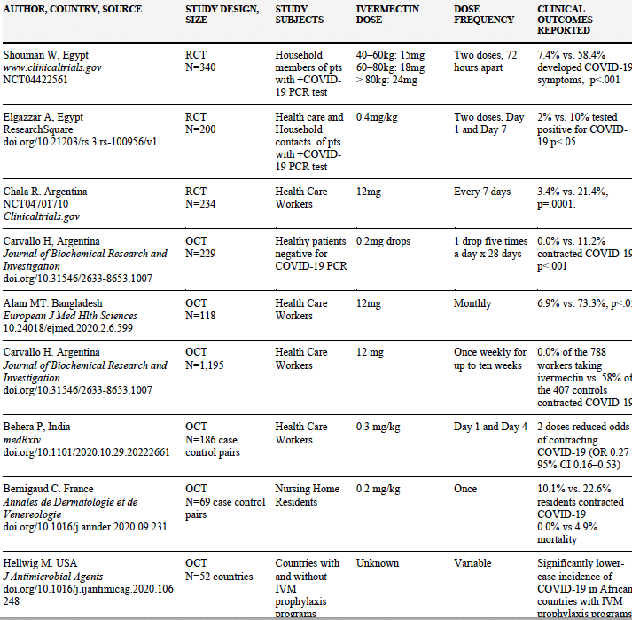
Prophylaxis Trials Data – 3 RCT’s (n=774), 5 OCT’s (n=2,052)

Slide 16
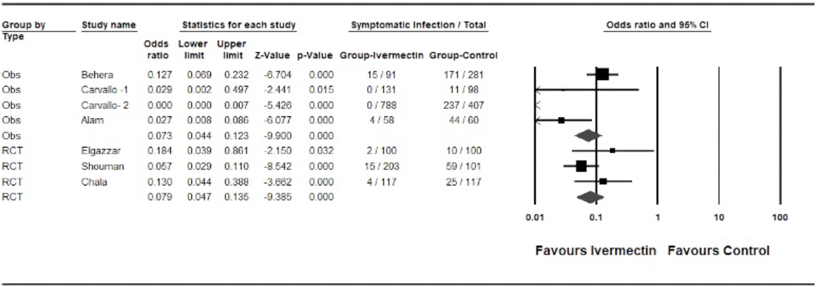
Meta-Analysis of Ivermectin Prophylaxis Studies

Slide 17
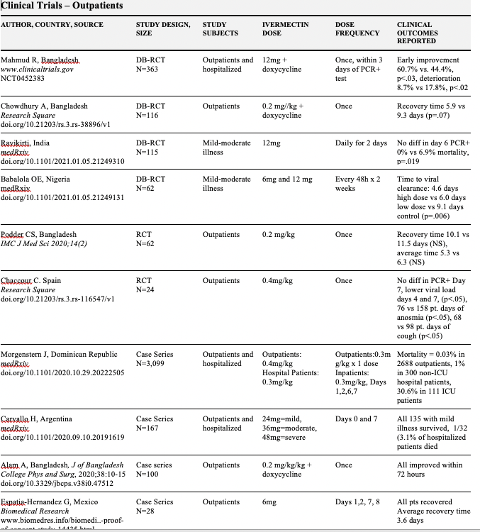
Mild-Moderate Illness Trials -6 RCT’s (n=742 pts), 4 Case series (n=3,394)

Slide 18
Effects of Ivermectin on viral clearance in randomized trials – dosing on Day 1 only
Study | Country (n) | Daily dose | Duration | Viral load endpoint | Result IVA vs Control | P value
Mahmud et al | Bangladesh, n=363 | 12 mg | 1 day (DB) | Detectable Day 14 | 8% vs 20% | p < 0.001
Asghar et al | Pakistan, n=103 | 0.2 mg/kg | 1 day | Undetectable Day 7 | 90% vs 44% | p < 0.001
Chowdhury | Bangladesh, n=112 | 0.2 mg/kg | 1 day (DB) | Time to PCR neg | 9 vs 9.3 days | p = n.s.
Podder et al | Bangladesh, n=62 | 0.2 mg/kg | 1 day (OL) | Day 10 PCR neg | 90% vs 95% | p = n.s.
Raad et al | Lebanon, n=100 | 0.2 mg/kg | 1 day | Day 3 | Ct values | p = 0.01
Mohan et al | India, n=157 | 0.2 – 0.4mg/kg Elixir | 1 day | Undetectable Day 5 | 48% vs 31% | p = n.s.

Slide 19
Effects of Ivermectin on viral clearance in randomized trials – multi-day dosing
Study | Country (n) | Daily dose | Duration | Viral load endpoint | Result IVA vs Control | P value
Elgazzar et al Mild / moderate | Egypt, n=200 | 0.4 mg/kg | 5 days (OL) | Days detectable | 5 vs 10 days | p < 0.001
Elgazzar et al Severe | Egypt, n=200 | 0.4 mg/kg | 5 days (OL) | Days detectable | 6 vs 12 days | p < 0.001
Okomus et al | Turkey, n=60 | 0.2 mg/kg | 5 days (DB) | Day 10 PCR Neg | 88% vs 38% | p = 0.01
Garrahan et al | Argentina, n=45 | 0.6 mg/kg | 5 days | PK/PD | Dose-related | p = 0.02
Babaloa et al * | Nigeria, n=60 | 0.1-0.2 mg/kg | 2 / week (DB) | Time to PCR neg | 2 x faster clearance | p = 0.003
Ahmed et al * | Bangladesh, n=72 | 0.2 mg/kg | 5 days (DB) | Time to PCR neg | 7 vs 14 days | p = 0.005
* dose-response effects seen

Slide 20
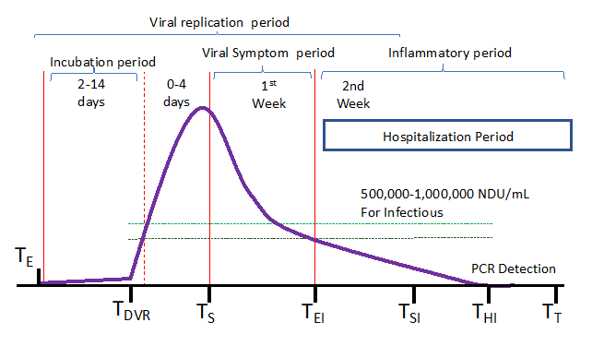
Could it work in Hospitalized Patients and why?
We know that viral replication is either severely diminished or absent by the time patients enter the hospital
It is the non-viable RNA fragments of SARS-CoV-2 that provoke an overwhelming and injurious inflammatory response

Slide 21
Could it work in Hospitalized Patients and why?
IVERMECTIN appears to have profound anti-inflammatory activity
A growing list of studies are identifying anti-inflammatory mechanisms
  Inhibition of cytokine production after lipopolysaccharide exposure
  downregulation of transcription of NF-kB (most potent trigger of inflammation)
  Limit the production of both nitric oxide and prostaglandin E₂

Slide 22
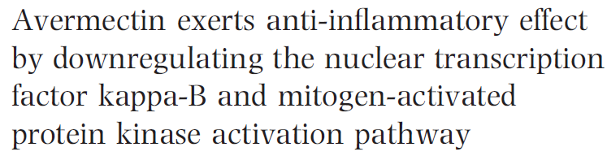
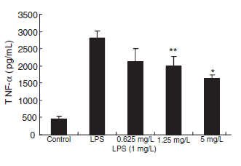
Signal transduction studies showed that avermectin significantly inhibits NF-κB
p65 translocation into the nucleus
Chi X, et al. Fundamental & Clinical Pharmacology 2009; 23:449–455

Slide 23
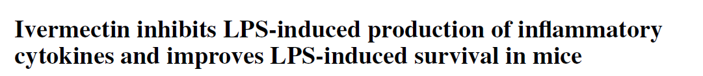
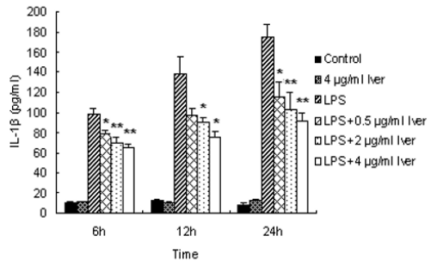
Zhang, X et al. Inflamm. Res. 57 (2008) 524–529

Slide 24
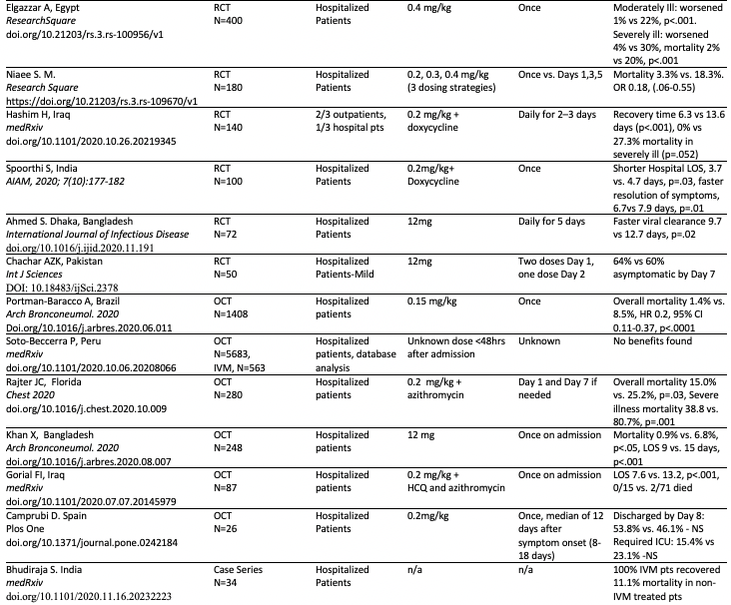
Hospitalized Patients Trials – 6 RCT’s (n=942), 5 OCT’s (n=2,612)

Slide 25
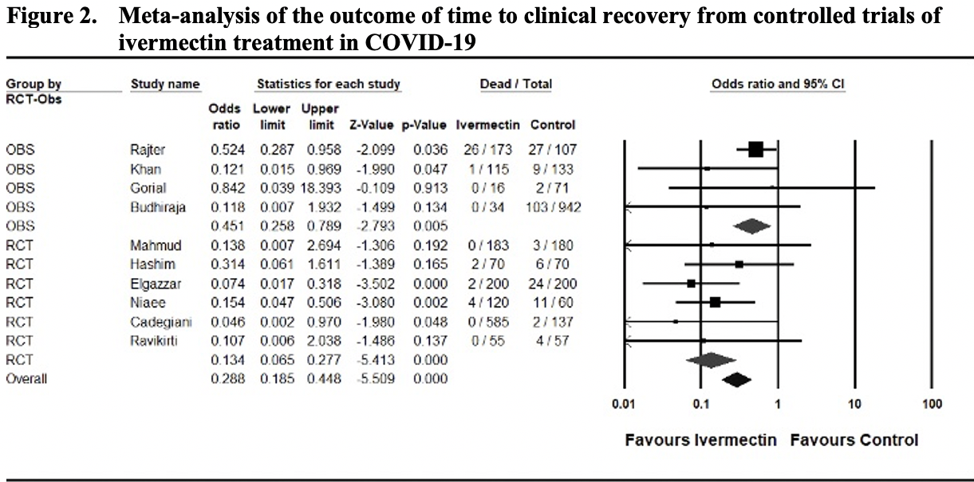
Meta-Analysis - Time to Clinical Recovery or LOS

Slide 26
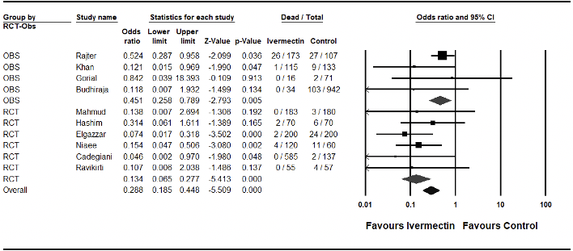
Meta-Analysis of Mortality in COVID-19

Slide 27
THE REAL-WORLD EVIDENCE
We must thank the following sources for the clinical and epidemiologic data:
  Juan Chamie, a data analyst from Columbia, now living in the US, has been compiling and analyzing data from South American countries since April after first reports of effectiveness of ivermectin in Columbia and Peru
  Alan Cannell, a British engineer who lives in Brazil who also stated compiling data on case counts and deaths in the Brazilian cities that initiated ivermectin distribution campaigns
  TrialSiteNews –for meticulously and immediately posting news of all the emerging trials evidence reviewed, as well as the work of Chamie and Cannell above
  Paul E. Marik, MD – for getting the FLCCC to focus on ivermectin ☺

Slide 28
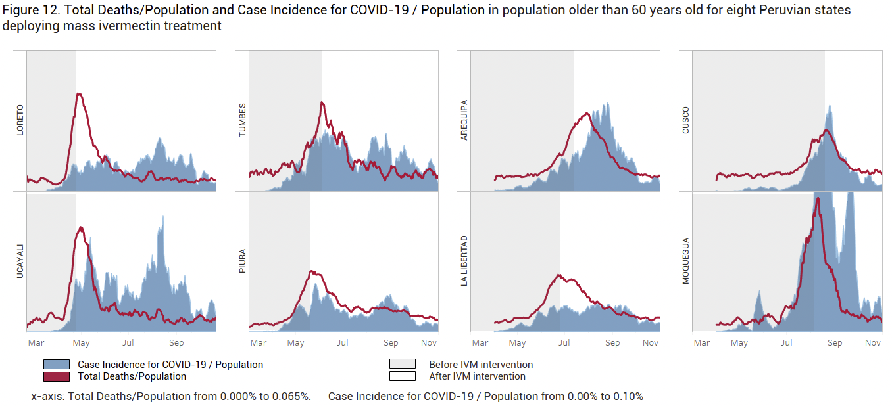
Antiviral Research 2020;178:104787

Slide 29
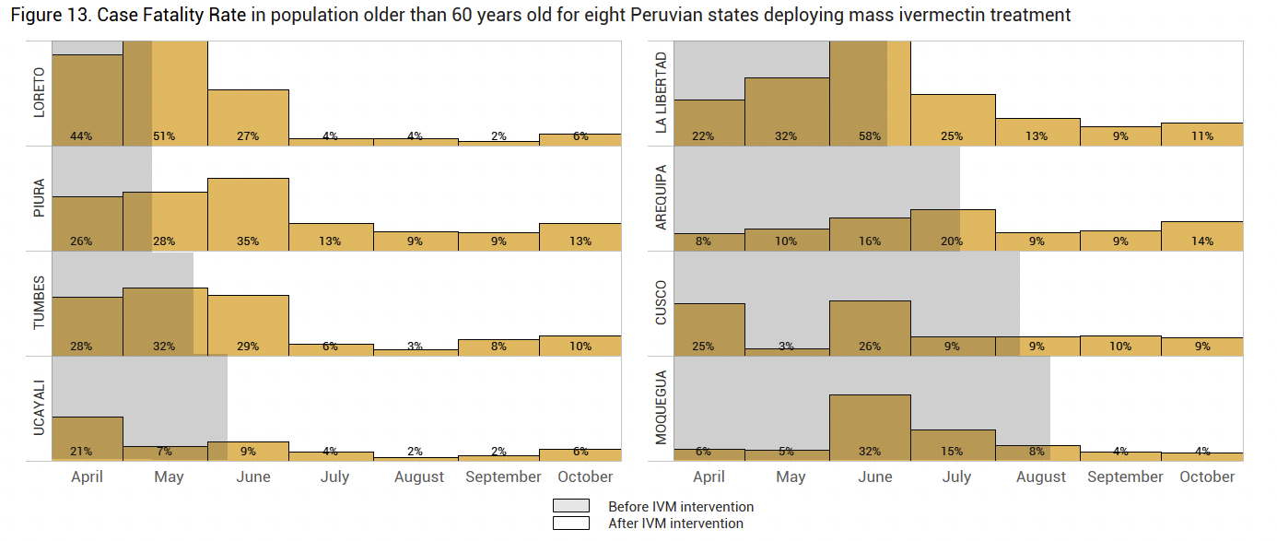

Slide 30
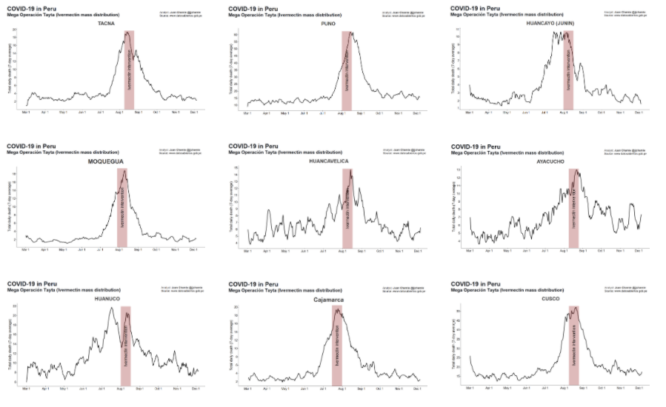
“Mega Operacion Tayta” – August 2020 Prophylaxis protocol targeting elderly and most risk challenged people in Peru

Slide 31
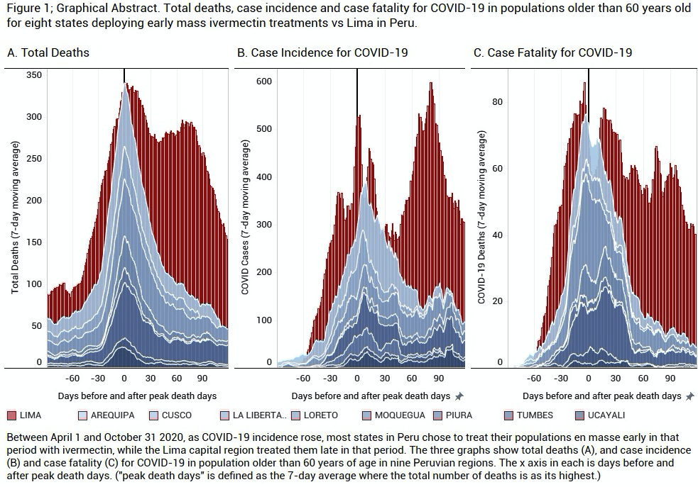
In Lima, Peru (in red).. No ivermectin distribution campaign took place

Slide 32
A Tale of Three Cities in Brazil
Case count decreases in Brazilian cities with ivermectin distribution programs
(yellow rows are cities that distributed ivermectin, neighboring city in same region did not)
Region | Confirmed new cases/month | June | July | August | Population 2020 (1000) | % August vs. June/July
South | Itajaí | 2123 | 2854 | 998 | 223 | 40%
 | Chapecó | 1760 | 1754 | 1405 | 224 | 80%
North | Macapá | 7966 | 2481 | 2370 | 503 | 45%
 | Ananindeua | 1520 | 1521 | 1014 | 535 | 67%
North East | Natal | 9009 | 7554 | 1590 | 890 | 19%
 | João Pessoa | 9437 | 7963 | 5384 | 817 | 62%

Slide 33
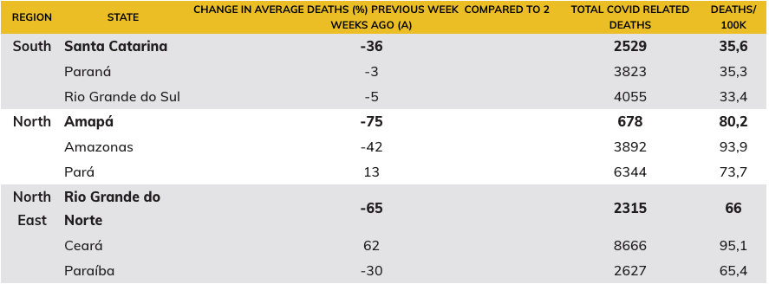
A Tale of Three Cities in Brazil

Slide 34
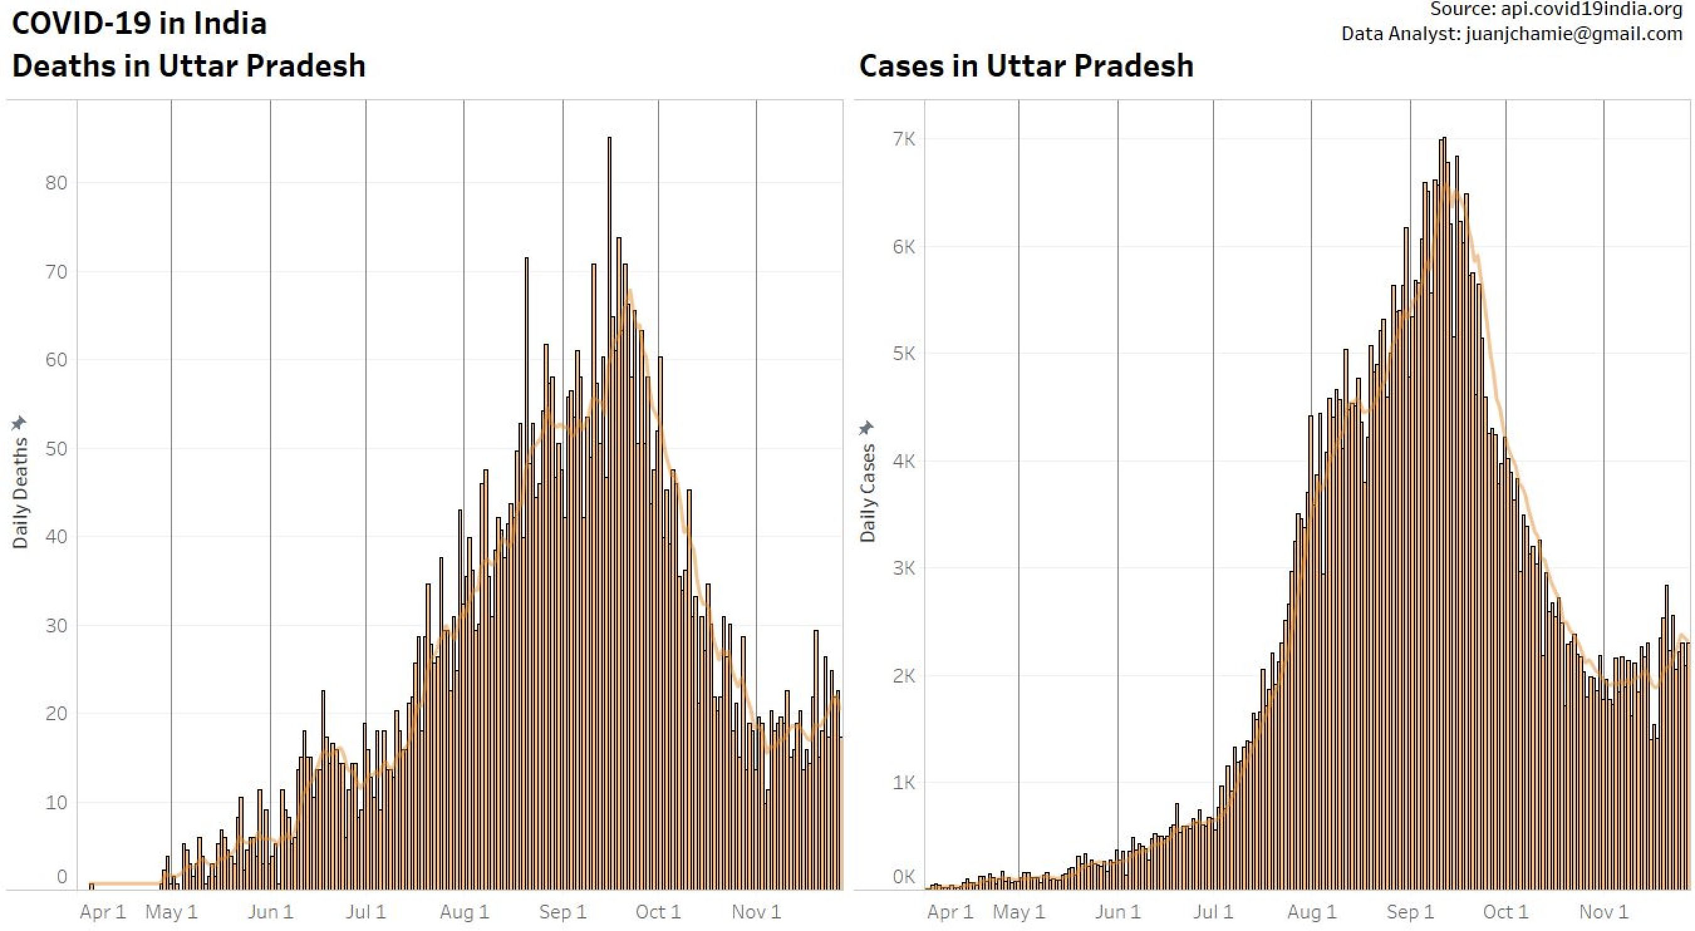
AUGUST 8
India, (Uttar Pradesh): 210 million given Ivermectin replacing HCQ as treatment.
AUGUST 22
In Lucknow, 40 kiosks opened to distribute Ivermectin.
August 8
August 22
August 8
August 22

Slide 35
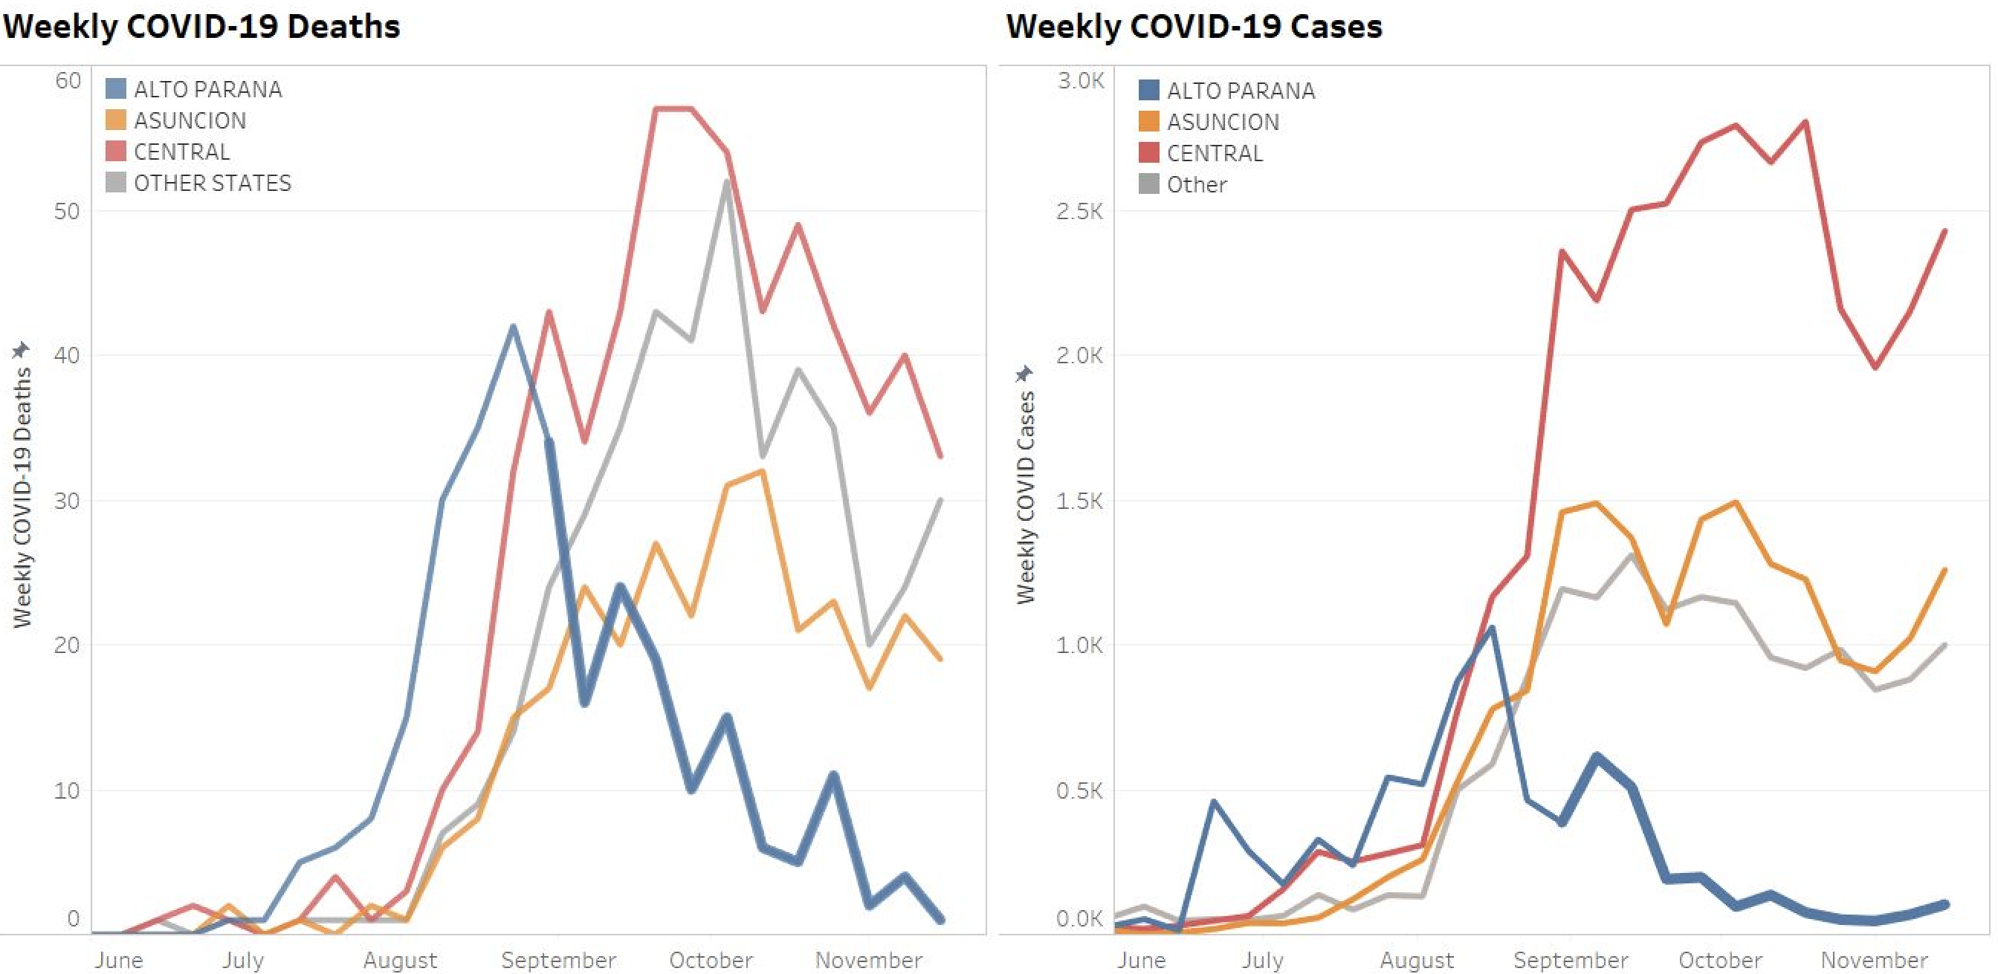
COVID19 IN PARAGUAY

Slide 36
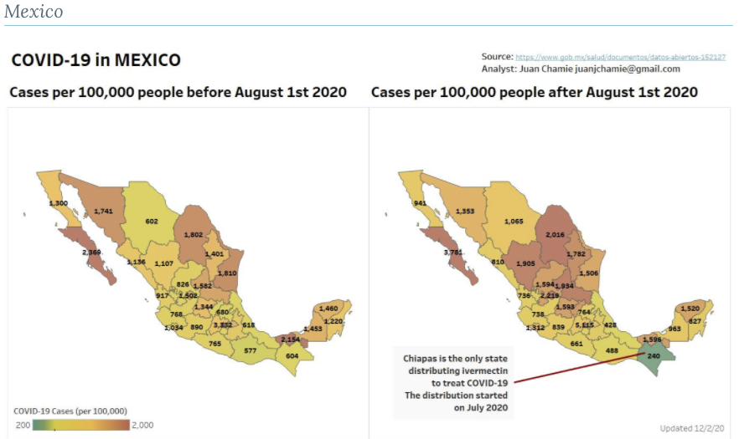
COVID19
IN MEXICO

Slide 37
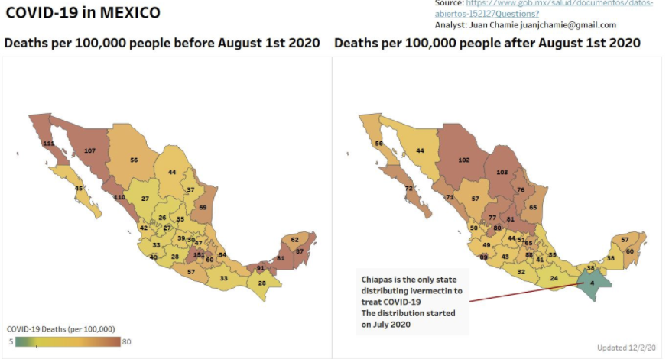
COVID19
IN MEXICO

Slide 38
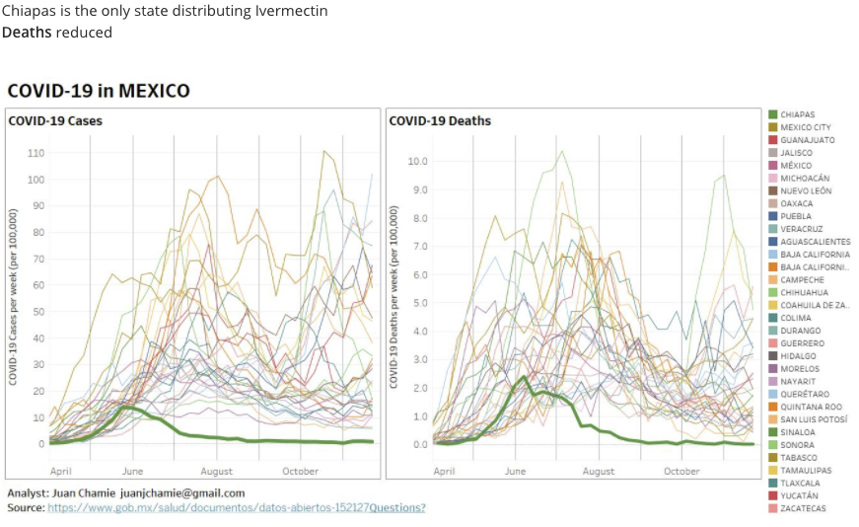
COVID19
IN MEXICO

Slide 39
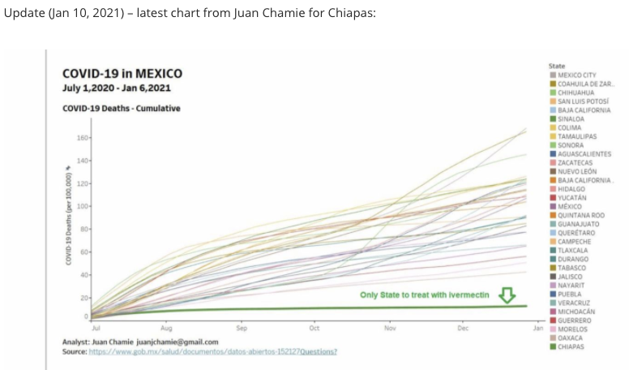
COVID19
IN MEXICO

Slide 40
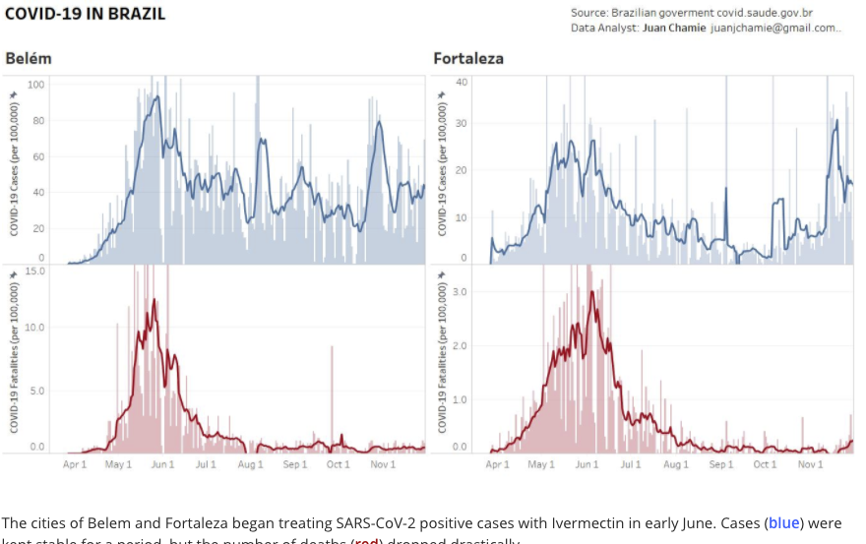
Back to Brazil

Slide 41
COVID19
IN MEXICO

Slide 42
COVID19
IN MEXICO

Slide 43
COVID19
IN MEXICO

Slide 44
Why isn’t everyone using it? Lets review some criticisms:
  “Majority of studies are observational, uncontrolled trials” - FALSE
    all the observational trials have control groups, well matched or propensity matched
    OCT’s and RCT’s have reached similar conclusions throughout the history of evidence-based medicine
    OCT’s are the most ethical approach to studying effective therapies in a pandemic
  “Majority of studies have not been published in peer-reviewed journals” – IRRELEVANT
    12 of the 24 trials have been published in peer-reviewed journals
    Every therapeutic in COVID-19 was adopted from pre-print data prior to peer review
      Remdesivir, corticosteroids, monoclonal antibodies, convalescent plasma come to mind
      ** Hydroxychloroquine and convalescent plasma were widely adopted before any data supported use
      *** Inoculations of vaccines began.. prior to a pre-print version of the vaccine trial was even available
  “Majority of the trials were performed abroad and are not generalizable to our patients” - ABSURD
    This deserves no further comment except to note it’s undercurrent of racism and/or immovable skepticism
  “Majority of the trials were not randomized controlled trials” – FALSE
    15 of the 24 controlled trials were… randomized

Slide 45
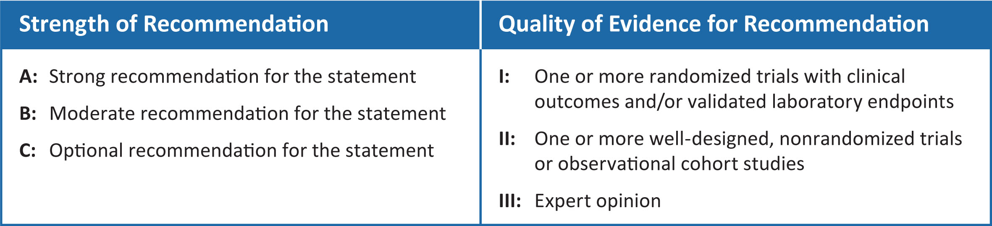
NIH Recommendation Rating Scheme
On August 27th, the NIH recommended ”against the use of ivermectin outside of clinical trials” with an A-III Rating
  A = STRONG
  III = EXPERT OPINION ONLY
On January 14th, the NIH upgraded their recommendation:

Slide 46
NIH Guideline Committee Recommendation on Ivermectin use in COVID-19
January 14th, 2021
  “The COVID-19 Treatment Guidelines Panel has determined that currently there are insufficient data to recommend either for or against the use of ivermectin for the treatment of COVID-19. Results from adequately powered, well-designed, and well-conducted clinical trials are needed to provide more specific, evidence-based guidance on the role of ivermectin for the treatment of COVID-19.

Slide 47
NIH Guideline Committee Recommendation on Ivermectin use in COVID-19
FLCCC Response: We are grateful that the Panel has upgraded their recommendation from “against use” to the same recommendation that supports monoclonal antibodies and convalescent plasma, both therapies widely used in the U.S. We must emphasize that although the recommendation for these therapies are identical, ivermectin holds several important characteristics distinct from those therapies;
Ivermectin is the ONLY one of these 3 therapies that has multiple randomized controlled trials (RCT’s) and a meta-analysis of RCT’s that demonstrate statistically significant:
  Faster times to viral clearance
  Faster times to clinical recovery or hospital length of stay
  Large reductions in mortality rates
  A profound reduction in the infectivity rate in both pre and postexposure prophylaxis studies.
Ivermectin is the ONLY one of these 3 therapies that is widely available, low cost, given orally, and safe to use in nearly all clinical situations.
3) Furthermore, Remdesivir has a level BIIa recommendation (for patients who require minimal supplemental oxygen) yet there is no published evidence that this drug has any positive impact on any patient centered outcome, e.g. death.

Slide 48
NIH Summary Description of the Evidence Base
“Some clinical studies showed no benefits or worsening of disease after ivermectin use,¹¹⁻¹⁴ whereas others reported shorter time to resolution of disease manifestations attributed to COVID-19,¹⁵⁻¹⁸ greater reduction in inflammatory markers,^{16,17} shorter time to viral clearance,^{11,16} or lower mortality rates in patients who received ivermectin than in patients who received comparator drugs or placebo.^{11,16,18”}

Slide 49
FLCCC response:
FLCCC Response: We strongly object to the suggestion that there is a clinical study with sufficient evidence to conclude there is worsening of disease after ivermectin use. The one reference that this statement is likely based on, a study by Soto-Becerra et al, is clearly a flawed study and the NIH panel should have been easily able to determine that. That study consisted of a pharmacy database analysis which attempted to compare patient groups that received either hydroxychloroquine, azithromycin, or ivermectin to those that received supportive care only. In each treatment group, a large number of early deaths occurred while none occurred in the control group, clearly indicating that the sicker and more imminently dying patients received some form of “experimental treatment”. If a study of this quality and design had instead somehow concluded a benefit for ivermectin, it would have been rapidly dismissed… as it should be in this case.

Slide 50
The NIH Treatment Guidelines Panel’s List of “Limitations” of the existing evidence base:
NIH Limitation #1: The sample size of most of the trials was small”
FLCCC Response:
“Small” is not defined. To point out that no single trial contains thousands of patients is absurdly obvious. A trial of such a size requires either “Big Pharma”, the NIH, or a well-resourced academic medical centers to fund. None have done so.
Small trials are not a limitation given that the strongest form of medical evidence does not arise from a single, large multi-center, double-blind RCT but instead comes only out of meta-analyses of RCT’s. Meta-analyses of RCT’s provide the most certain estimate of treatment effects, much more so than any single trial can. The NIH is fully aware that the WHO is currently performing such a meta-analysis, and at the time of our combined presentation to the NIH panel (we presented alongside the WHO expert consultant, Dr. Andrew Hill) they were provided the results of a meta-analysis which included 18 RCT’s and over 2,100 patients.
The trials on Ivermectin are not ”small”, which we define as less than 100 patients (a number traditionally quoted as being required to confidently detect a mortality benefit from a therapy. The size of just the treatment trials of ivermectin in COVID-19 (ignoring the prophylaxis trials for a moment) consist of seven RCT’s of over 100 patients each (most with several hundred) with another 4 that have over 50 patients in each.

Slide 51
NIH Limitation #2: “Various doses and schedules of ivermectin were used”
FLCCC Response: We strongly reject this as a “limitation” given the opposite is true, it is a strength. An evidence base consisting of varying treatment regimens allows for the identification of an optimal treatment strategy. Dr. Hill’s data compiled for Unitaid and the W.H.O, compares single day vs. multi-day dosing using various dose amounts which allows for a more thorough assessment of both safety and efficacy. Further, these data show a dose-response relationship which, when it exists, as it does with ivermectin, provides another pillar of scientific support for any therapeutic. It is these data which allowed us to develop our multi-day treatment protocol given these regimens showed the largest impacts on viral load, time to viral clearance, and time to clinical recovery or hospital length of stay.
An example of why studying various dosing strategies is a strength in the data and not a weakness can be seen in the weakness of the RECOVERY trial of corticosteroids, a study that, although it found a mortality benefit of corticosteroids in moderate to severe COVID-19 patients and thus transformed the treatment of COVID-19, it did so with a dosing regimen that is far too low for most hospital patients as evidenced by the small mortality reduction it achieved in patients on oxygen. The global health community has unfortunately adopted this dosing regimen despite the numerous trials showing far greater impacts on mortality using higher doses and/or different corticosteroids. Thus, a single trial using a single protocol does not allow for the identification of an optimal therapeutic strategy. Further, the lack of recognition that COVID-19 respiratory disease is NOT a viral pneumonia or ARDS is a colossal system wide diagnostic failure. All must read the following paper:

Slide 52
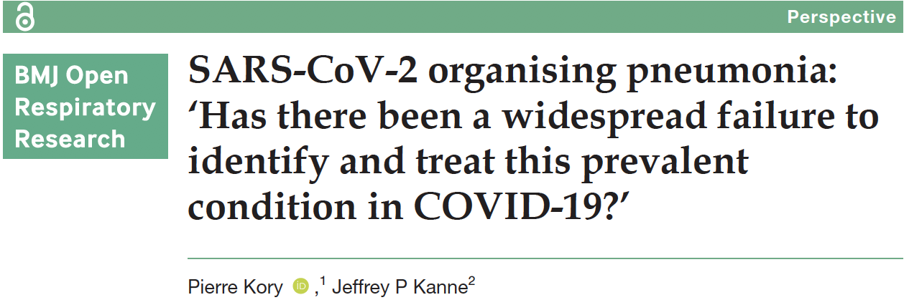
COVID-19 IS NOT A VIRAL PNEUMONIA

Slide 53
NIH Limitation #3: “Some of the randomized controlled trials were open-label studies in which neither the participants nor the investigators were blinded to the treatment arms”
FLCCC Response: Although open-label studies can lead to bias when measuring “subjective” endpoints, the NIH panel is ignoring the fact that multiple objective endpoints were used in the majority of trials. These objective endpoints include viral load, viral clearance, and death, none of which can be subjectively influenced. All these objective endpoints are profoundly and statistically significantly positive in over a dozen studies and in meta-analysis.

Slide 54
NIH Limitation #4: “In addition to ivermectin or the comparator drug, patients also received various concomitant medications (e.g., doxycycline, hydroxychloroquine, azithromycin, zinc, corticosteroids), confounding assessment of the true efficacy or safety of ivermectin.”
FLCCC Response: This is a thoroughly invalid criticism of the current data. By definition, a randomized controlled trial randomizes patients to an arm treated with the investigational drug as compared to a control group/placebo group, with all other factors being equal to negate the influence of confounding variables. It would be unethical if patients in the treatment arm and the control arm received no other therapeutic interventions for a potentially fatal disease. In essence these trials compared the local standard of care (SOC) to the standard of care plus the investigational drug (ivermectin). A number of the RCTS performed a direct head-to-head evaluation comparing the SOC plus hydroxychloroquine versus SOC versus ivermectin; this trial design allows the efficacy of each compactor drug to be assessed; the validity of such a trial design is widely accepted by the scientific community On occasion, ivermectin was paired with doxycycline, and in one instance, tested against HCQ as the control group (which was a profoundly positive study in favor of ivermectin). Further, doxycycline has not been shown to have impacts in COVID-19, and studies with and without concomitant use of doxycycline show similar impacts.

Slide 55
NIH Limitation #5: “The severity of COVID-19 in the study participants was not always well described”
FLCCC Response: This concern is irrelevant when considering that the trials consistently show ivermectin is effective in prophylaxis, early, and late phase disease. There is no data to suggest the efficacy of ivermectin is restricted to any single phase or severity of the disease.

Slide 56
NIH Limitation #6: “The study outcome measures were not always clearly defined”
FLCCC Response: Although this is a true statement, it again ignores the many “objective” endpoints that were clearly defined (viral load, time to viral clearance) or required no definition (i.e. death)

Slide 57
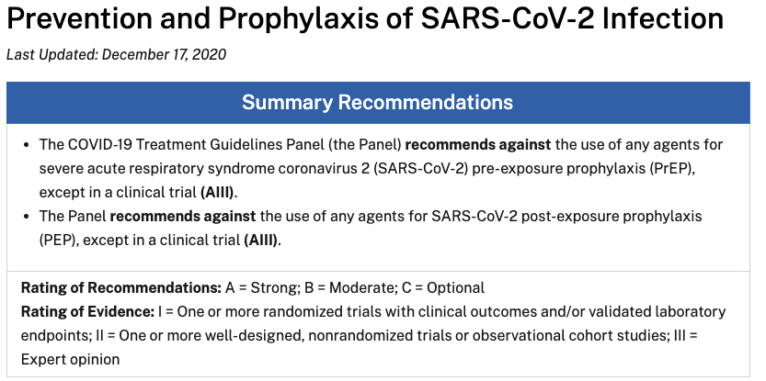
NIH Guideline Recommendation on Prophylaxis for COVID-19

Slide 58
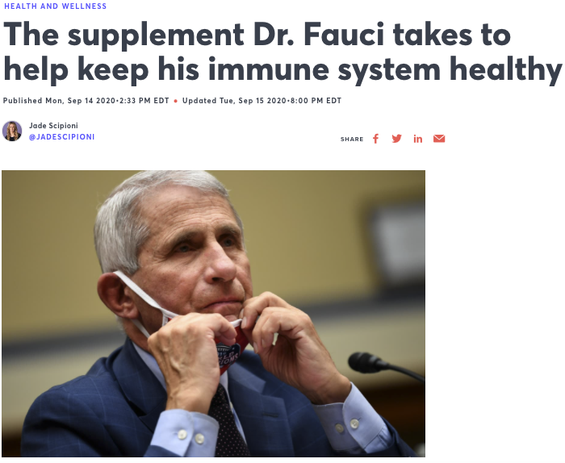
Dr. Fauci takes Vitamin C and Vitamin D as prophylaxis
https://urldefense.com/v3/__https:/www.cnbc.com/2020/09/14/supplements-white-house-advisor-fauci-takes-every-day-to-help-keep-his-immune-system-healthy.html__;!!Aeua5Q!H_yEIbxKCw57pbav6wmuTbe0-ekdfie_ab75tDkwDyaV1quxgRWRnhFQ9OCcaOg$

Slide 59
CONCLUSION
The consistency and magnitude of benefit amongst numerous trials of varying designs from multiple centers and countries around the world is both unique in the history of evidence-based medicine and supports immediate and widespread adoption.
  I have never in my career reviewed and compiled a clinical evidence base for any medicine or intervention with the reproducibility of study data as I have observed with ivermectin in the prophylaxis and treatment of COVID-19
    This statement applies to the dataset reviewed, without incorporating the powerful epidemiologic findings by Juan Chamie repeatedly showing population-wide impacts on case counts and fatality rates in the cities and regions across the world that initiated ivermectin distribution campaigns during COVID-19

